Slide 1
THE BUDGET PROCESS
KAJIADO COUNTY TREASURY
BUDGET AND ECONOMIC PLANNING DEPARTMENT

Slide 2
INTRODUCTION
Legislations guiding the budget process
  Constitution of Kenya (2010) - Sections 215–219, 220–224
  Public Finance Management Act (2012) - Sections 25–27, 35–45, 117–118, 125–137, 189–191
  County Government Act (2012) - Section 91 (c)

Slide 3
Budget Preparation Phases
Planning Phase
Budget Estimates Preparation
Budget Approval
Budget Implementation
Monitoring and Evaluation

Slide 4
The Budget Formulation
Planning phase –This is where high-level policy decisions inform the govt. budget decisions.
This stage involves translating broad policy goals into financial targets, given expected conditions in the economy and society
Revenue forecasting is done at this stage to determine how much money is anticipated in the coming periods, leading to the setting of a resource envelope target

Slide 5
Planning Phase Cont..
  County Government Resource Envelope
  County share of revenue from the National Government
  County Own Source Revenue
  Grants from the Equalization Fund
  Domestic Borrowing
  Conditional and non-conditional grants from the national government e.g KUSUP, KISIP, FLLoCA
  Conditional and non-conditional grants from the development partners e.g Nutrition International
  Potential external support (grants and loans)

Slide 6
Planning Phase Cont..
  Computations are done for planned expenditures
    The aim is to generate estimates of the spending needs in different sectors, or spending areas (like functions or programs).
  Expenditure estimates (also called ceilings) are used to indicate the maximum amount of funding available to each spending entity (MDA) or for specific objectives in the coming budget

Slide 7
Planning Phase Cont..
This phase involves preparation of
  The County Integrated Development Plan and the Annual Development Plan
  The County Budget and Review Outlook Paper
  The County Fiscal Strategy Paper
County Macro Working Group Establishes county resource envelope and expenditure ceilings.
County Sector Working Groups are charged with the responsibility of formulating sector budgets.

Slide 8
Stakeholders consulted in the budget Process:
  Citizens
  County Budget and Economic Forum (CBEF)
  County Executive Committee (CEC)
  County Assembly
  Controller of Budget (COB)
  Commission on Revenue Allocation (CRA)

Slide 9
2. Budget Preparation Phase
This involves the preparation of the CG budget estimates to be submitted to the County Assembly (CA).
The Medium Term Expenditure Framework (MTEF) guides budget preparation process.
The budget is prepared using the program based budget (PBB) format.
The County Treasury plays a central role in coordinating compilation of the detailed expenditure plans for each county entity.
The County Treasury produces detailed projections of available resources while on the other hand it works with County sectors/entities to assess their expenditure requests.

Slide 10
3. Budget Approval Phase
Budget Estimates is submitted for approval to the County Assembly. This is where legislative debate and enactment takes place.
CA interrogates the budget estimates in details, in Committees, and with support from technical experts.
Members of the County Executive have to defend the budget estimates before CA Committees. The budget proposal is debated and can sometimes be amended but this has to take into account the principles of fiscal responsibility.
At the end of this period the budget proposal is formally adopted and enacted into law (Appropriation Act), authorizing the executive to raise and spend resources accordingly.

Slide 11
4. Budget Implementation
It involves implementation of the approved budget by the various county entities.
The County Treasury coordinates mobilization of resources to finance all the county entities
County entities are responsible for execution of their respective budgets – procurement process project/program execution…

Slide 12
Budget Evaluation
Accounting and evaluation of county government’s budgeted revenues and expenditures
Annual Audits,
Monitoring and Evaluation of the budget programs and projects
Annual Progress Reports (APR)

Slide 13
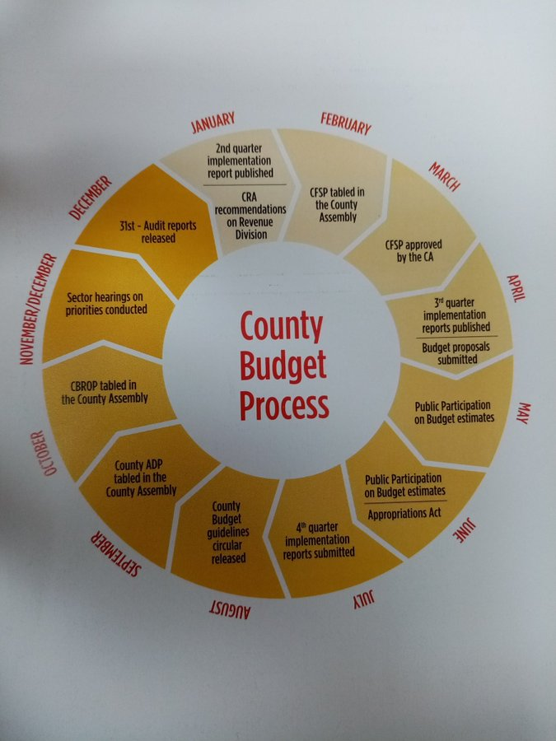

Slide 14
Budget Calendar—Key Dates
Key Dates | Budget Activity
30TH AUGUST | COUNTY BUDGET CALENDER ISSUED
1ST SEPTEMBER | CIDP/ ANNUAL DEVELOPMENT PLAN SUBMITTED
30TH SEPTEMBER | SUBMISSION OF COUNTY BUDGET REVIEW AND OUTLOOK PAPER
28TH FEBRUARY | SUBMISSION OF COUNTY FISCAL STRATEGY PAPAPER & DEBT MANAGEMENT STRATEGY
30TH APRIL | SUBMISSION OF BUDGET ESTIMATES
30TH JUNE | BUDGET ESTIMATES APPROVAL

Slide 15
THANK YOU

